Slide 1
CS61C: Great Ideas in Computer Architecture (aka Machine Structures)
Lecture 10: RISC-V Part 3: Control Flow, Bitwise Ops
Instructors: Lisa Yan, Justin Yokota

Slide 2
Agenda
C Control Flow and goto
Reducing C with goto
RISC-V Control Flow
RISC-V Bitwise Operations

Slide 3
Agenda
C Control Flow and goto
Reducing C with goto
RISC-V Control Flow
RISC-V Bitwise Operations

Slide 4
RISC-V Guiding Philosophy
Goal of assembly: Create a set of instructions such that:
Each instruction represents a single computation or "step"
Ex. add adds two registers together, addi adds a register and an immediate
Every C program can be broken down into instructions
Ex. a = b+c+d; -> a = b+c; -> add x5 x6 x7 a = a+d; add x5 x5 x8
Each instruction works in isolation without depending on context
A program's behavior should depend only on memory, registers, and the current line being run
RISC: There should be as few unique instructions as possible

Slide 5
Control Flow in C
In C, we run code one line at a time.
Most of the time, when we run a line of code, the next line that we will run is the line immediately afterwards
A few lines make it so that the next line isn't the line immediately afterwards, but somewhere else (we "jump" to another line of code).
int x = 5; int y = 10; int z = x+y;
Current Line
Next Line

Slide 6
Control Flow in C
Lines in C that affect program flow:
If statements
if(cond) { line; }
line;
Current Line
Next Line if cond
Next Line if !cond

Slide 7
Control Flow in C
Lines in C that affect program flow:
If statements
If-else statements
if(cond) { line; } else { line; } line;
Current Line
Next Line if cond
Next Line if !cond

Slide 8
Control Flow in C
Lines in C that affect program flow:
If statements
While Loops
while(cond) { line; line; }
Next Line
Current Line

Slide 9
Control Flow in C
Lines in C that affect program flow:
If statements
While Loops
Do-While Loops
do { line; line; } while(cond); line;
Next Line if cond
Current Line
Next Line if !cond

Slide 10
Control Flow in C
Lines in C that affect program flow:
If statements
While Loops
For Loops
for(line;cond;line) { line; line; } line;
Current Line (cond)
Next Line if cond
Next Line if !cond

Slide 11
Control Flow in C
Lines in C that affect program flow:
If statements
While Loops
For Loops
Break/Continue
while(true) { line; break; } line;
Current Line
Next Line

Slide 12
Control Flow in C
Lines in C that affect program flow:
If statements
While Loops
For Loops
Break/Continue
Function Calls
int foo(n) { int a = 5; return a+n; } ... line; foo(5); line;
Next Line
Current Line

Slide 13
Control Flow in C
Lines in C that affect program flow:
If statements
While Loops
For Loops
Break/Continue
Function Calls
Both the function call, and the return!
Return line depends on which line called foo.
More on this Friday
int foo(n) { int a = 5; return a+n; } ... line; foo(5); line; foo(5); line;
Current Line
Next Line?
Next Line?

Slide 14
New C operator: goto and Labels
A label is an identifier to a particular line of code
Doesn't count as a line of code itself; merely "points out" a particular line
Each label must have a unique name (like variable names)
The goto statement changes the next line to be run to the labelled line
The label can be either before or after the goto statement.
Target: line; line; line; goto Target; line;
Next Line
Current Line

Slide 15
goto Example: Handling Mallocs
int* a = malloc(sizeof(int)*1000);
int* b = malloc(sizeof(int)*1000000);
int* c = malloc(sizeof(int)*1000000000);
FILE* d = fopen(filename);

Slide 16
goto Example: Handling Mallocs
int* a = malloc(sizeof(int)*1000);
int* b = malloc(sizeof(int)*1000000);
int* c = malloc(sizeof(int)*1000000000);
FILE* d = fopen(filename);
Bad code: malloc can fail (returning NULL), and we should catch that before it causes a segfault

Slide 17
goto Example: Handling Mallocs
int* a = malloc(sizeof(int)*1000);
if(a == NULL) allocation_failed();
int* b = malloc(sizeof(int)*1000000);
if(b == NULL) allocation_failed();
int* c = malloc(sizeof(int)*1000000000);
if(c == NULL) allocation_failed();
FILE* d = fopen(filename);
if(d == NULL) allocation_failed();

Slide 18
goto Example: Handling Mallocs
int* a = malloc(sizeof(int)*1000);
if(a == NULL) allocation_failed();
int* b = malloc(sizeof(int)*1000000);
if(b == NULL) allocation_failed();
int* c = malloc(sizeof(int)*1000000000);
if(c == NULL) allocation_failed();
FILE* d = fopen(filename);
if(d == NULL) allocation_failed();
Bad code: leaks memory since a gets allocated but never freed.

Slide 19
goto Example: Handling Mallocs
int* a = malloc(sizeof(int)*1000);
if(a == NULL) allocation_failed();
int* b = malloc(sizeof(int)*1000000);
if(b == NULL) {
free(a);
allocation_failed();
}
int* c = malloc(sizeof(int)*1000000000);
if(c == NULL) {
free(b);
free(a);
allocation_failed();
}
FILE* d = fopen(filename);
if(d == NULL) {
free(c);
free(b);
free(a);
allocation_failed();
}

Slide 20
goto Example: Handling Mallocs
int* a = malloc(sizeof(int)*1000);
if(a == NULL) goto ErrorA;
int* b = malloc(sizeof(int)*1000000);
if(b == NULL) goto ErrorB;
int* c = malloc(sizeof(int)*1000000000);
if(c == NULL) goto ErrorC;
FILE* d = fopen(filename);
if(d == NULL) {
free(c);
ErrorC: free(b);
ErrorB: free(a);
ErrorA: allocation_failed();
}

Slide 21
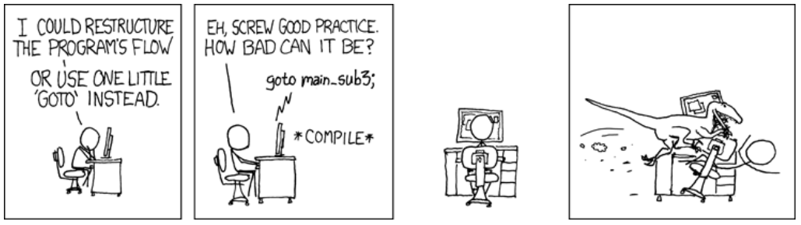
NEVER USE goto!!!!
goto has a tendency to create completely illegible code
Generally considered bad practice, except in very specific situations
Error handling
Jumping out of nested loops
Even with the above, there are other approaches that don't use goto
Nevertheless, goto is useful in that we can create any other control flow statements with just goto and conditional goto statements
Notes:
Source: https://xkcd.com/292/

Slide 22
Agenda
C Control Flow and goto
Reducing C with goto
RISC-V Control Flow
RISC-V Bitwise Operations

Slide 23
Reducing C with goto: Break
while(true) { line; break; } line;

Slide 24
Reducing C with goto: Break
while(true) { line; goto AfterWhile; } AfterWhile: line;

Slide 25
Reducing C with goto: If
if(cond) {
line;
line;
} else {
line;
line;
}
line;

Slide 26
Reducing C with goto: If
if(cond) goto IfCase;
goto ElseCase;
IfCase:
line;
line;
goto AfterIf;
ElseCase:
line;
line;
AfterIf: line;

Slide 27
Reducing C with goto: If without an Else
if(!cond) goto AfterIf;
line;
line;
AfterIf: line;

Slide 28
Reducing C with goto: Do-While
do {
line;
line;
} while(cond)
line;

Slide 29
Reducing C with goto: Do-While
Loop: line;
line;
if(cond) goto Loop;
line;

Slide 30
Reducing C with goto: While
while(cond) {
line;
line;
}
line;

Slide 31
Reducing C with goto: While
Loop: if(!cond) goto AfterLoop;
line;
line;
goto Loop;
AfterLoop: line;

Slide 32
Reducing C with goto: For
for(startline;cond;incline) {
line;
line;
}
line;

Slide 33
Reducing C with goto: For
startline;
while(cond) {
line;
line;
incline;
}
line;

Slide 34
Reducing C with goto: For
startline;
Loop: if(cond) goto AfterLoop
line;
line;
incline;
goto Loop
AfterLoop: line;

Slide 35
Agenda
C Control Flow and goto
Reducing C with goto
RISC-V Control Flow
RISC-V Bitwise Operations

Slide 36
RISC-V Control Flow Operations
Like in C, RISC-V allows you to write labels to signify particular lines of code
RISC-V has instructions for both conditional and unconditional jumps:
j Label
Jumps to the specified label
Technically a pseudoinstruction; more on this Friday
Branch instructions:
General format: bxx rs1 rs2 Label
Jumps to the specified Label if the condition is met
If the condition is not met, just moves to the next line

Slide 37
RISC-V Control Flow Operations
List of branch instructions:
beq rs1 rs2 Label: Branch if EQual
bne rs1 rs2 Label: Branch if Not Equal
blt rs1 rs2 Label: Branch if Less Than (signed) (rs1 < rs2)
bge rs1 rs2 Label: Branch if Greater or Equal (signed)
bltu rs1 rs2 Label: Branch if Less Than (unsigned)
bgeu rs1 rs2 Label: Branch if Greater or Equal (unsigned)
Note that bgt, bgtu, ble, and bleu are pseudoinstructions (can make them by reversing inputs of existing instructions)

Slide 38
RISC-V Control Flow Operations: Example
int a = 0;
for(int i = 0; i < 10; i++) {
if(i == 7) {
break;
}
a = a + i;
}
a = a + 50;

Slide 39
RISC-V Control Flow Operations: Example
int a = 0;
for(int i = 0; i < 10; i++) {
if(i == 7) goto End;
a = a + i;
}
End: a = a + 50;

Slide 40
RISC-V Control Flow Operations: Example
int a = 0;
int i = 0;
Loop: if(i >= 10) goto End;
if(i == 7) goto End;
a = a + i;
i = i + 1;
goto Loop;
End: a = a + 50;

Slide 41
RISC-V Control Flow Operations: Example
int a = 0;
int i = 0;
Loop:
int j = 10;
if(i >= j) goto End;
j = 7;
if(i == j) goto End;
a = a + i;
i = i + 1;
goto Loop;
End: a = a + 50;

Slide 42
RISC-V Control Flow Operations: Example
li x10 0 #int a = 0;
li x5 0 #int i = 0;
Loop:
li x6 10 #int j = 10;
bge x5 x6 End #if(i >= j) goto End;
li x6 7 #j = 7;
beq x5 x6 End #if(i == j) goto End;
add x10 x10 x5 #a = a + i;
addi x5 x5 1 #i = i + 1;
j Loop #goto Loop;
End: addi x10 x10 50 #a = a + 50;

Slide 43
Agenda
C Control Flow and goto
Reducing C with goto
RISC-V Control Flow
RISC-V Bitwise Operations

Slide 44
Review: Bitwise Operations in C
Bitwise AND, OR, XOR, and NOT
Perform the operation on the binary one bit at a time
Ex. 0b1001 | 0b0111 = 0b1111
Ex. 0b1001 & 0b0111 = 0b0001
Ex. 0b1001 ^ 0b0111 = 0b1110
Ex. ~0b1001 = 0b0110
Left and Right Shift
Shift the bits of the number left/right, then fill the remaining bits
Ex. 0b0001 << 3 = 0b1000 = 8
Ex. 0b1011 >> 2 = 0b0010 = 2

Slide 45
Review: Bitwise Operations in C
Shifts have numerical equivalents in math
Left Shift by n -> Multiply by 2^{n}
Right Shift by n -> (Floor) Divide by 2^{n}
For left shifts, we always fill the new bits with 0s
For right shifts, dividing an unsigned number should fill the bits with 0s
But right-shifting a signed number shouldn't fill with 0s always
Ex. 0b1000 0010 = -126 in 8 bits. If we right-shift by 1 and fill with 0s, we get 0b0100 0001 = 65. But if we right-shift by 1 and fill with the sign bit, we get 0b1100 0001 = -63 = -126/2

Slide 46
Review: Bitwise Operations in C
Logical Left Shift
Shift left, add zeros
Same as multiplication by a power of 2
Logical Right Shift
Shift right, zero-extend
Same as dividing an unsigned number by a power of 2
Arithmetic Right Shift
Shift right, sign-extend
NOT the same as dividing a signed number by a power of 2
C standard is to round towards zero, while right-shift always rounds down

Slide 47
Arithmetic Operations in RISC-V
RISC-V has many arithmetic operations:
add rd rs1 rs2: Add
sub rd rs1 rs2: Subtract
and rd rs1 rs2: Bitwise AND
or rd rs1 rs2: Bitwise OR
xor rd rs1 rs2: Bitwise XOR
sll rd rs1 rs2: Shift Left Logical
srl rd rs1 rs2: Shift Right Logical
sra rd rs1 rs2: Shift Right Arithmetic
Each one has a corresponding immediate version (ex. xori rd rs1 imm runs a bitwise XOR on a register and immediate)

Slide 48
Arithmetic Operations that AREN'T in RISC-V
There's a few notable omissions in this list:
Bitwise NOT
Exists as a pseudoinstruction; can be run by doing a bitwise XOR with 0xFFFF FFFF = -1
Multiplication, Division, Mod
Circuit is significantly more complicated than bitwise ops or addition.
Exists as an extension of RISC-V, but is not by itself in base RISC-V
For multiplying/dividing by powers of 2, we can use shifts instead
Float addition/subtraction/etc.
Much more complicated circuit, so also exists as an extension.

Slide 49
Practice: Bitwise Operations
What is in register x12 after the following instructions?
li x10 0x34FF
slli x12 x10 0x10
srli x12 x12 0x08
and x12 x12 x10

Slide 50
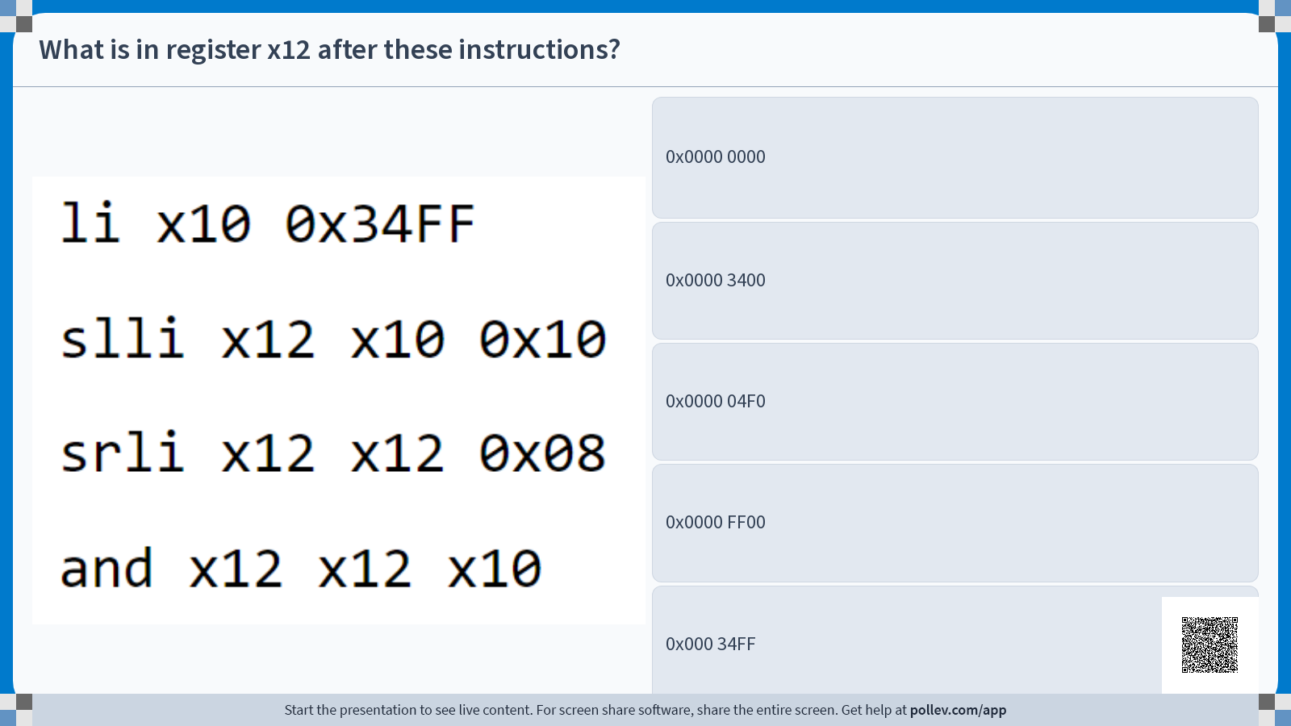

Slide 51
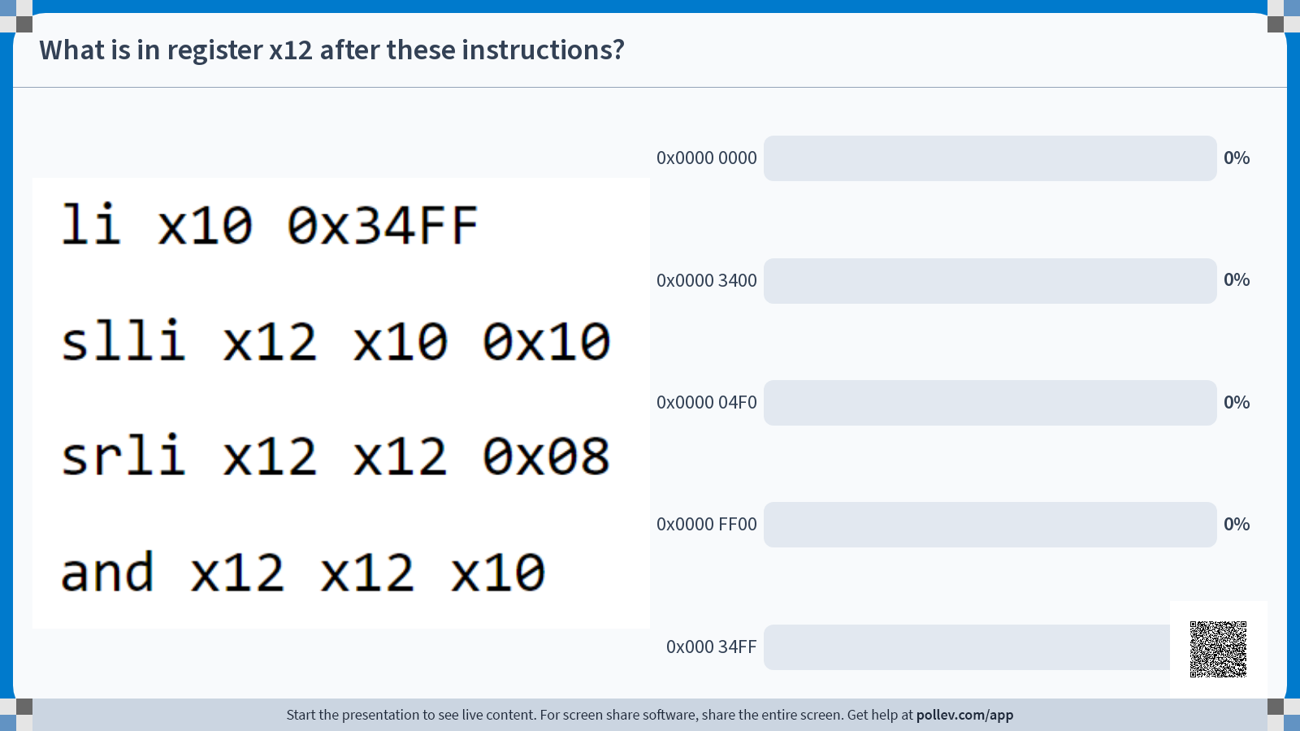

Slide 52


Slide 53
Practice: Bitwise Operations
What is in register x12 after the following instructions?
li x10 0x34FF
slli x12 x10 0x10
srli x12 x12 0x08
and x12 x12 x10
Register | Value
x10 | 0x0000 0000
x12 | 0x0000 0000

Slide 54
Practice: Bitwise Operations
What is in register x12 after the following instructions?
li x10 0x34FF
slli x12 x10 0x10
srli x12 x12 0x08
and x12 x12 x10
Register | Value
x10 | 0x0000 34FF
x12 | 0x0000 0000

Slide 55
Practice: Bitwise Operations
What is in register x12 after the following instructions?
li x10 0x34FF
slli x12 x10 0x10
srli x12 x12 0x08
and x12 x12 x10
Register | Value
x10 | 0x0000 34FF
x12 | 0x34FF 0000

Slide 56
Practice: Bitwise Operations
What is in register x12 after the following instructions?
li x10 0x34FF
slli x12 x10 0x10
srli x12 x12 0x08
and x12 x12 x10
Register | Value
x10 | 0x0000 34FF
x12 | 0x0034 FF00

Slide 57
Practice: Bitwise Operations
What is in register x12 after the following instructions?
li x10 0x34FF
slli x12 x10 0x10
srli x12 x12 0x08
and x12 x12 x10
Register | Value
x10 | 0x0000 34FF
x12 | 0x0000 3400

Slide 58
Summary: RISC-V so far
Arithmetic
add
sub
and
or
xor
sll
srl
sra
Immediate
addi
andi
ori
xori
slli
srli
srai
li (pseudo)
Loads/Stores
lw
lb
lbu
sw
sb
Branches/Jumps
beq
bne
bge
blt
bgeu
bltu
j (pseudo)

